Slide 1

iOS App Development with Xamarin and F#
Twitter: @rachelreese
Blog: Rachelree.se
Github: rachelreese
Notes:
Play Minesweeper game.
I work at FFL using iOS and F#.
Just helped start the Nash F# UG & am involved in the Nashville Xamarin UG. One of the LambdaLadies founders.
Slides up after the talk.
You should all move to Nashville!!! :D

Slide 2

Why F#?
Notes:
Maybe you’re a C# dev or maybe you’re an iOS dev right now. Why should you switch?

Slide 3
F#…offers us an order of magnitude increase in productivity and allows one developer to perform the work…of a team of dedicated developers on an existing Java-based solution...
Yan Cui
Lead server Engineer, Gamesys (source)

Slide 4
I have now delivered three business critical projects written in F#. I am still waiting for the first bug to come in. This is not the case with the C# projects I have delivered.
Simon Cousins
UK-based Power Company (Source)
Notes:
Clarity & conciseness of code.

Slide 5
The UI work is especially gratifying, because state of the art for a lot of genomic data display is still PNG images embedded in JavaScript and with F# I can render half a million data points on a web page without jumping through hoops.
Darren Platt
Amyris Biotechnology (source)
Notes:
F# gets flack for lack of UI support.
Not using editors: true for every gui technology. Winforms & ASP.NET, amirite?

Slide 6
F# Fundamentals
operaHouses //(Name, Current Productions) for each opera house
|> Array.map (fun (x,y) -> x, y |> Seq.toArray)) |> Array.filter (fun (x,y) -> y.Length > 0)
|> Significant whitespace Immutable by default
StartNewGame <| GetNewGameBoard()
[1..10] |> List.filter (fun x -> x % 2 = 0) |> List.map (fun x -> x + 3) |> List.sum
//names is tuple of (name, id)
Array.Parallel.partition (fun g -> ids.Contains(snd g)) names |> fst
|> Array.toList
Notes:
Start with |>
Like unix shell scripting pipe
Flow works better backwards sometimes.
Note whitespace.

Slide 7
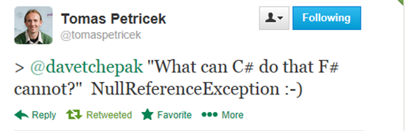
F# Fundamentals
Option Types
Quote of the Week blog post
Notes:
NullReferenceException can be obviated because of option types.
Similar to nullable<int> but different because:
Can be used on any type (strings, functions)
When pattern matched on, forces you to consider None case
Can use map, iter, etc. functions.
Nestable: Option<Option<int>> is valid.

Slide 8
F# Fundamentals: Concise Code with DUs
F#
C#
type Transport =
| Car of Make:string * Model:string
| Bus of Route:int
| Bicycle
public abstract class Transport{ }
public abstract class Car : Transport {
public string Make { get; private set; }
public string Model { get; private set; }
public Car (string make, string model) {
this.Make = make;
this.Model = model;
}
}
public abstract class Bus : Transport {
public int Route { get; private set; }
public Bus (int route) {
this.Route = route;
}
}
public class Bicycle: Transport { }
...
Notes:
Sort of like enums.
Can model smaller obj hierarchies with them, like here.

Slide 9
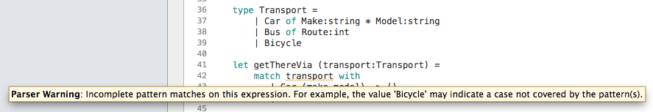
F# Fundamentals: Pattern Matching
type Transport = | Car of Make:string * Model:string | Bus of Route:int | Bicycle let getThereVia (transport:Transport) = match transport with | Car (make,model) -> () | Bus route -> ()
Notes:
Can pattern match on values, tuples, records, DUs.

Slide 10
Several reasons why you should learn F#
Discriminated unions
Immutable by default
Pattern matching
Option type
Custom operators
REPL

Slide 11
F# vs. Swift
Discriminated unions
‘Enums’
Immutable by default
Constant or Variable
Pattern matching
Enhanced switch
Option type
Optionals
Custom operators
Custom operators
REPL
REPL

Slide 12
But Swift is still missing out
No type providers
Lacks full type inference
No units of measure
Requires “return”
Still void, no unit
No parallelism & async!
Single platform
Young language
No easy cloning syntax for structures (e.g. records)
Literal data structures are only list and dict
Simpler garbage collection process
Active Patterns

Slide 13
Why F#?
Type Providers!
Units of Measure!
Notes:
Type providers are a way to return typed data from an external data source.
UoM because game physics
Phil tags some integers as <pixel> to represent actual screen space – plus self-documenting.
<Tasky Data demo>
<UoM demo>
<Freebase demo>

Slide 14
Some existing type providers.
powershell
Azure
Choose your own adventure
Matlab
RSS
Rock, Paper, Scissors
SignalR
FunScript
R
Python
MS Dynamics CRM
World Bank
CSV
XML
IKVM
SQL Server
SQL Server with EF
Hadoop
WSDL
OData
Apiary
Facebook
MVVMCross
Squirrels
File System
Dates
Oracle
Don Syme
XAML
Freebase
SQLite
JSON
Regex
LINQ
Minesweeper
See here for a full list.

Slide 15
Get creative.
Get data from
Hadoop
SQL Server
RSS
Freebase
CSV
OData
World Bank
JSON
Process with
Matlab
Powershell
Regex
R
SignalR
Python
LINQ
Visualize with
F#
Matlab
R
SQLite
Oracle

Slide 16
Why Xamarin?
Fully Native
Cross Platform
Notes:
Why not swift.
Why not PhoneGap.

Slide 17
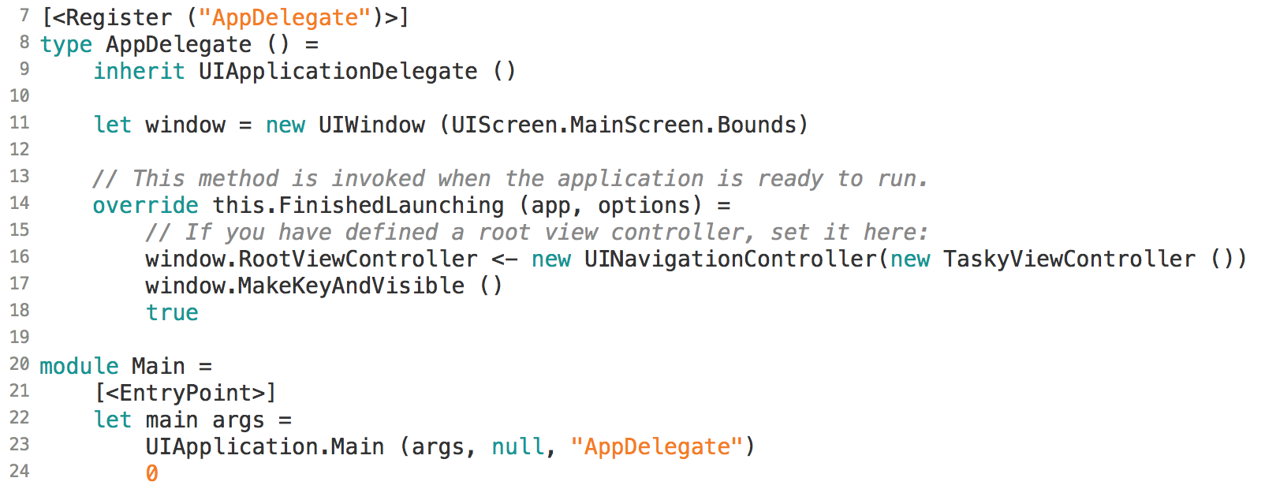
iOS Fundamentals: AppDelegate
Notes:
If currently an ios dev, this should look familiar because of all the UI-prefaced things.
AppDelegate must be registered
Main needs to be labeled as an Entry Point.
<- is assignment
FinishedLaunching:
Set root view controller.

Slide 18
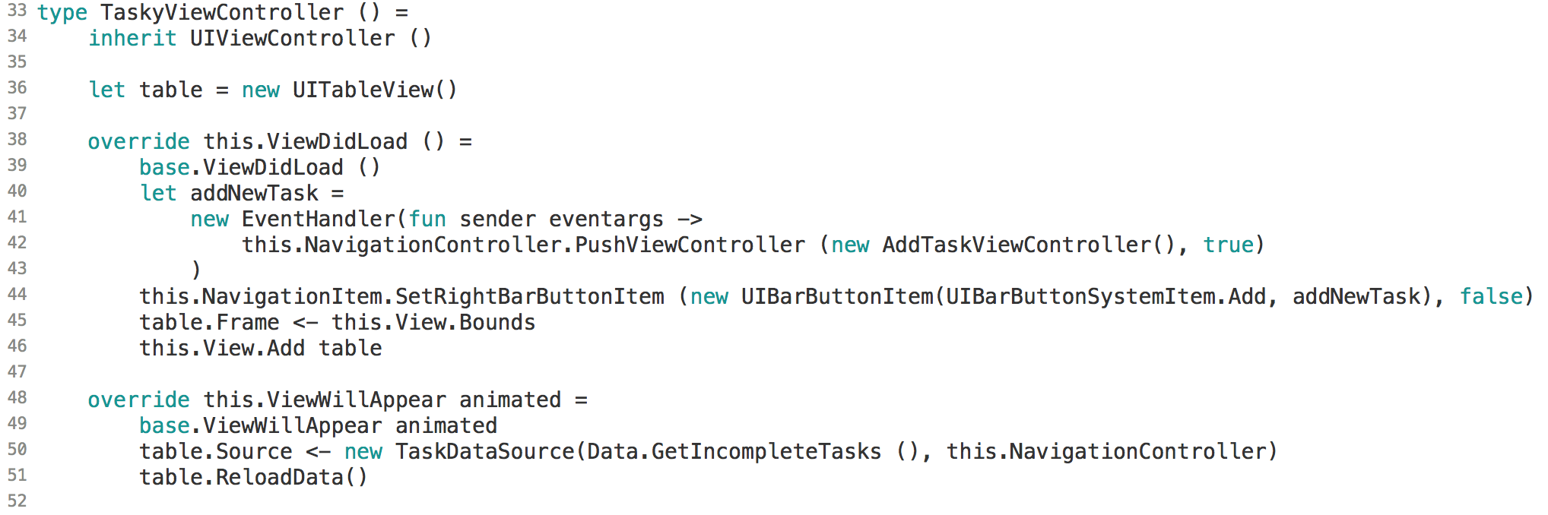
iOS Fundamentals: ViewController
Notes:
Inherit from UIViewController()
Override ViewDidLoad, ViewWillAppear, ViewDidAppear…

Slide 19

Minesweeper
Notes:
Also, finish looking at Tasky.

Slide 20
iOS App Development with Xamarin and F#
Twitter: @rachelreese
Blog: Rachelree.se
Github: rachelreese
Notes:
Work at FFL using iOS and F#.
Just helped start the Nash F# user group.
Previously ran VT Fun.
This was a difficult talk to put together. Half the room knows F#, but not iOS or Xamarin, and the other half’s the opposite.
Start w/ covering why you should consider F#
Then some language basics
And Xamarin basics.

